Slide 1
Election and Afghanistan Citizens
2019
A survey on peace and election
By ATN News

Slide 2
Purpose of the survey
To know what Afghan citizens want
What they prefer (Peace or Election)
Assist stakeholders in decision making by providing them a clear picture of citizens wants
Include citizens point of views in the peace process

Slide 3
Data
To complete this survey primary data was used
The data collected from:
  5379 citizens
  from 34 provinces of Afghanistan
  in three languages (Persian, Pashtu and Uzbeki)

Slide 4
Questionnaire
The questionnaire’s questions was selected by ATN news and there were three main question:
Do you want peace?
Do you want election?
Between peace and election, which one you prefer/select?

Slide 5
Data collection, Entry and Analysis
For collection of data a list of more than 5500 phone numbers was prepared by ATN news
Nai through a group of 15 people contacted all phone numbers as a result more than 5000 responses were collect (after validation only 5379 were selected for the survey)
For data analysis SPSS was used in order to categorize the data for further process.
Graphics were designed by ATN news team

Slide 6
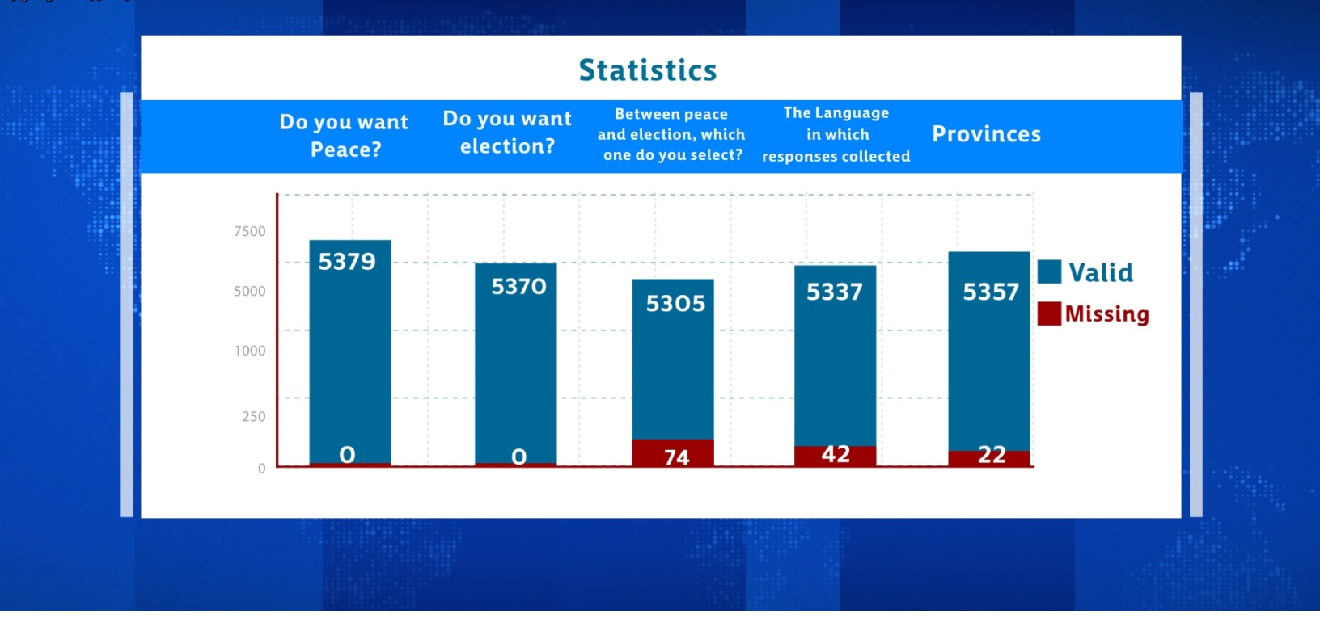
Findings

Slide 7
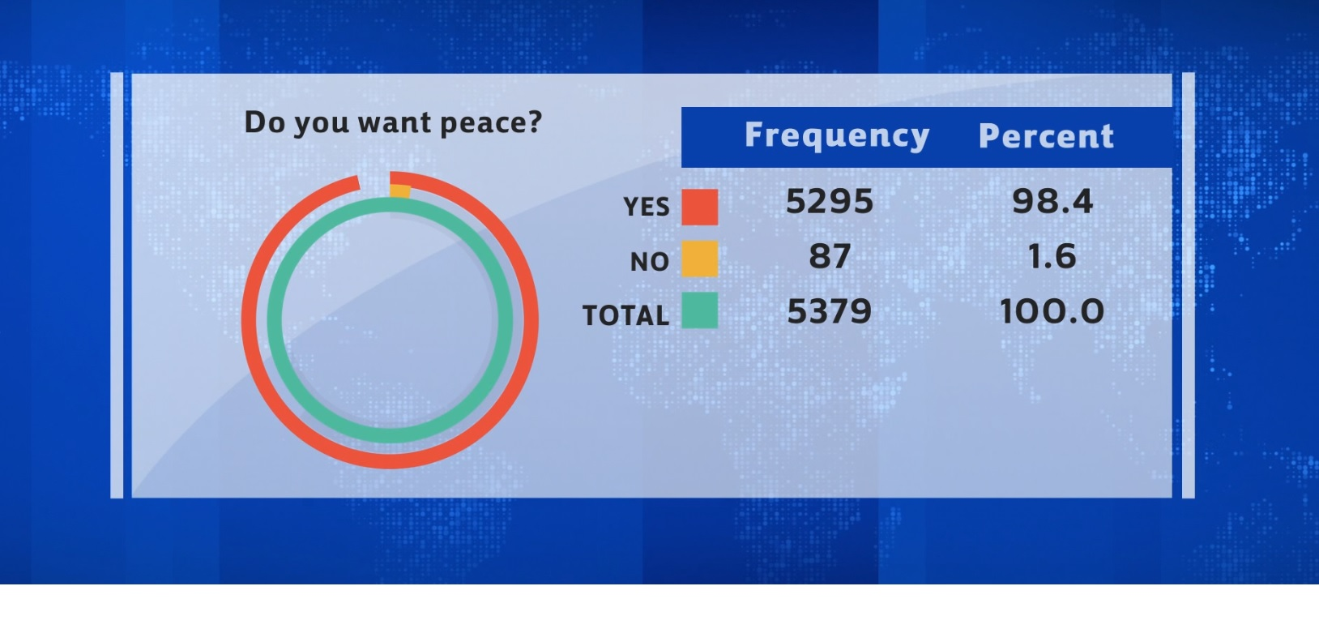
Findings (cont…)

Slide 8
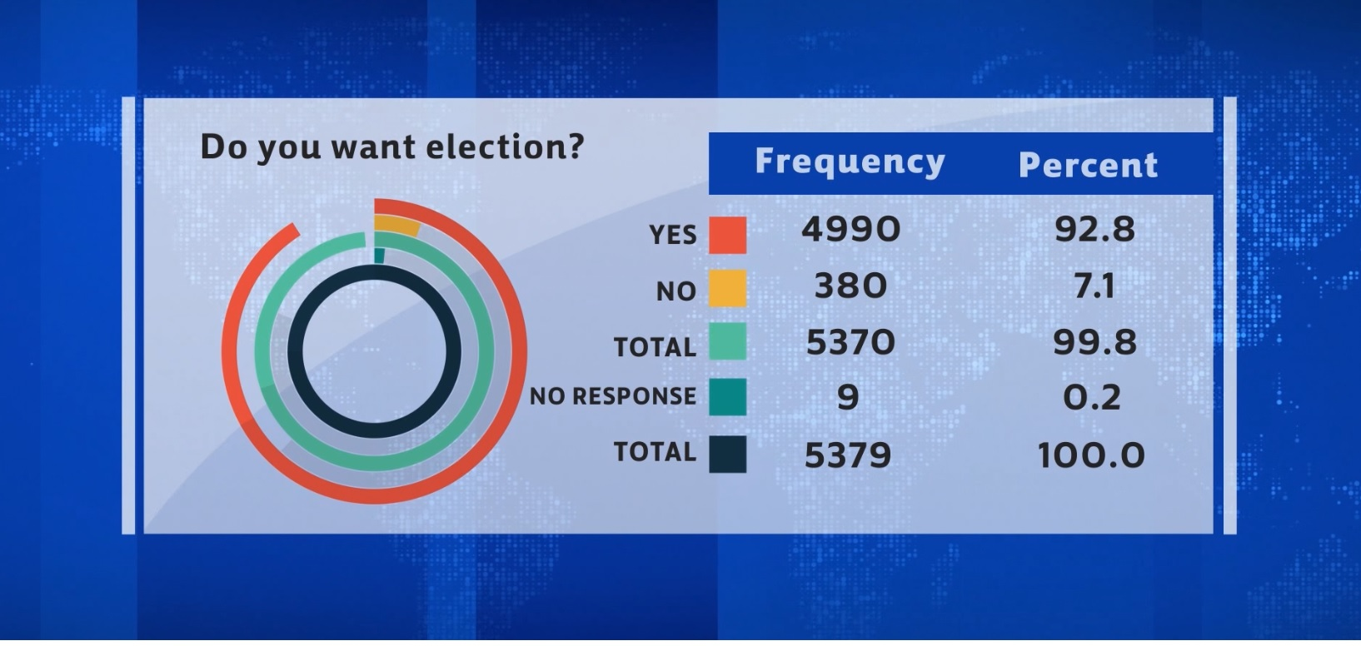
Findings (cont…)

Slide 9
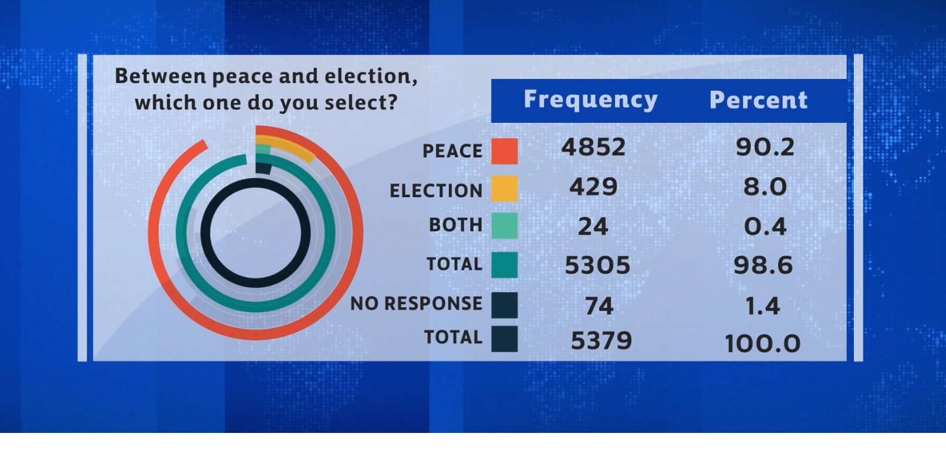
Findings (cont…)

Slide 10
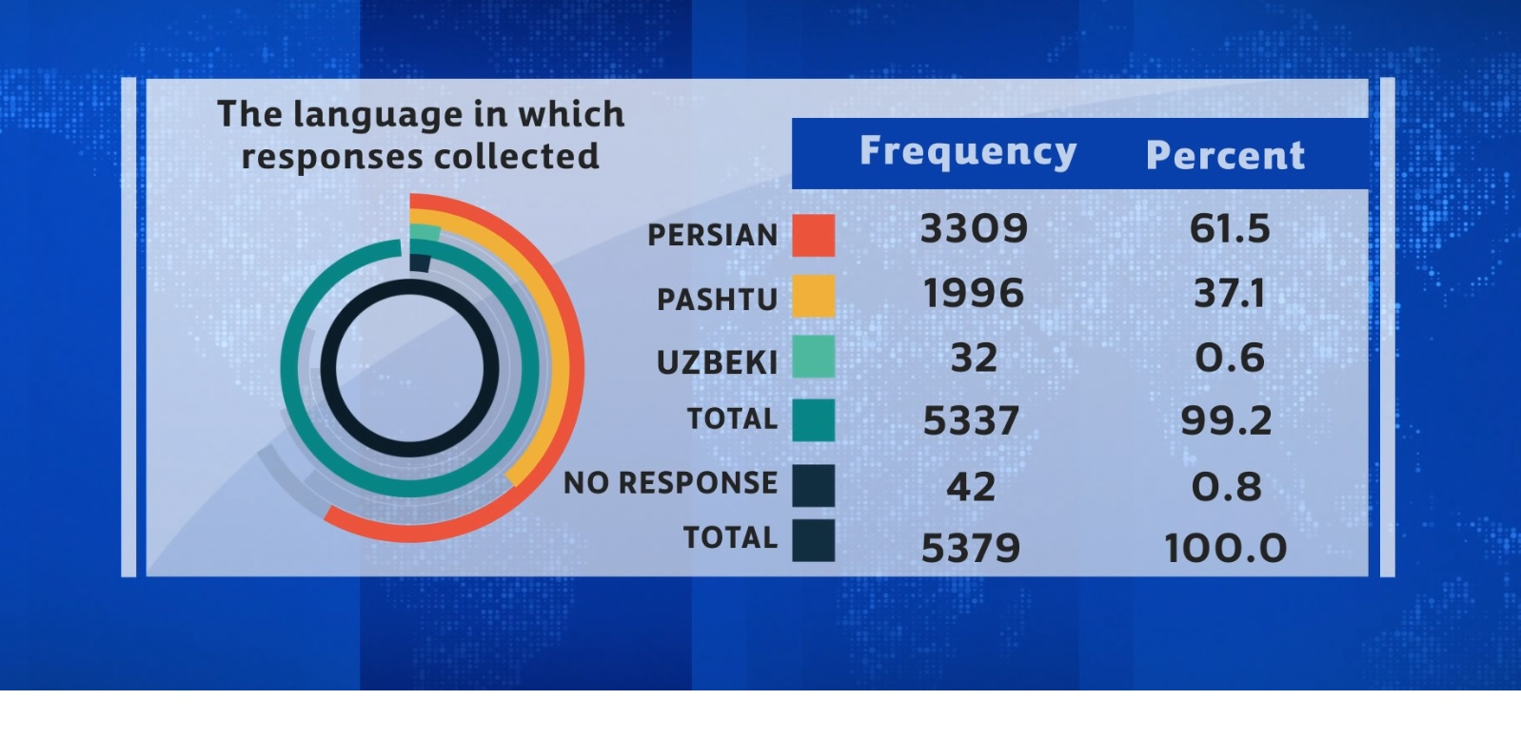
Findings (cont…)

Slide 11
Responses collected from each province

Slide 12
Responses collected from each province
Province | Frequency | Percent | Valid Percent | Cumulative Percent
Uruzgan | 6 | .1 | .1 | .1
Panjshir | 44 | .8 | .8 | .9
Takhar | 49 | .9 | .9 | 1.8
Jawzjan | 6 | .1 | .1 | 2.0
Khost | 259 | 4.8 | 4.8 | 6.8
Daikundi | 11 | .2 | .2 | 7.0
Zabul | 31 | .6 | .6 | 7.6
Sar-e-Pul | 58 | 1.1 | 1.1 | 8.7
Samangan | 27 | .5 | .5 | 9.2
Ghazni | 356 | 6.6 | 6.6 | 15.8
Faryab | 231 | 4.3 | 4.3 | 20.1
Badghis | 26 | .5 | .5 | 20.6
Farah | 107 | 2.0 | 2.0 | 22.6
Kunduz | 166 | 3.1 | 3.1 | 25.7
Kandahar | 947 | 17.6 | 17.7 | 43.4

Slide 13
Responses collected from each province (cont…)
Province | Frequency | Percent | Valid Percent | Cumulative Percent
Kabul | 1499 | 27.9 | 28.0 | 71.4
Kapisa | 16 | .3 | .3 | 71.7
Kunar | 39 | .7 | .7 | 72.4
Laghman | 19 | .4 | .4 | 72.7
Logar | 13 | .2 | .2 | 73.0
Nangarhar | 378 | 7.0 | 7.1 | 80.0
Nuristan | 17 | .3 | .3 | 80.4
Bamyan | 5 | .1 | .1 | 80.5
Nimroz | 33 | .6 | .6 | 81.1
Herat | 356 | 6.6 | 6.6 | 87.7
Helmand | 108 | 2.0 | 2.0 | 89.7
Wardak | 26 | .5 | .5 | 90.2
Ghor | 18 | .3 | .3 | 90.6
Badakhshan | 97 | 1.8 | 1.8 | 92.4
Baghlan | 57 | 1.1 | 1.1 | 93.4

Slide 14
Responses collected from each province (cont…)
Province | Frequency | Percent | Valid Percent | Cumulative Percent
Balkh | 252 | 4.7 | 4.7 | 98.1
Parwan | 19 | .4 | .4 | 98.5
Paktia | 71 | 1.3 | 1.3 | 99.8
Paktika | 10 | .2 | .2 | 100.0
Total | 5357 | 99.6 | 100.0
No Response | 22 | .4
Total | 5379 | 100.0

Slide 15
Province based responses to “Do you want peace”
Province | Yes | No | Total
Uruzgan | 6 | 0 | 6
Panjshir | 44 | 0 | 44
Takhar | 49 | 0 | 49
Jawzjan | 6 | 0 | 6
Khost | 255 | 4 | 259
Daikundi | 11 | 0 | 11
Zabul | 30 | 1 | 31
Sar-e-Pul | 52 | 6 | 58
Samangan | 27 | 0 | 27
Ghazni | 351 | 5 | 356
Faryab | 223 | 8 | 231
Badghis | 26 | 0 | 26
Farah | 106 | 1 | 107
Kunduz | 161 | 5 | 166
Kandahar | 936 | 11 | 947

Slide 16
Province based responses to “Do you want peace” (cont….)
Province | Yes | No | Total
Kabul | 1488 | 11 | 1499
Kapisa | 16 | 0 | 16
Kunar | 39 | 0 | 39
Laghman | 19 | 0 | 19
Logar | 13 | 0 | 13
Nangarhar | 376 | 2 | 378
Nuristan | 17 | 0 | 17
Bamyan | 2 | 3 | 5
Nimroz | 33 | 0 | 33
Herat | 349 | 7 | 356
Helmand | 106 | 2 | 108
Wardak | 26 | 0 | 26
Ghor | 18 | 0 | 18

Slide 17
Province based responses to “Do you want peace” (cont….)
Province | Yes | No | Total
Badakhshan | 97 | 0 | 97
Baghlan | 57 | 0 | 57
Balkh | 236 | 16 | 252
Parwan | 18 | 1 | 19
Paktia | 70 | 1 | 71
Paktika | 10 | 0 | 10
Total | 5273 | 84 | 5357

Slide 18
Province base responses to “Do you want election”
Province | Yes | No | Total
Uruzgan | 6 | 0 | 6
Panjshir | 43 | 1 | 44
Takhar | 45 | 3 | 48
Jawzjan | 6 | 0 | 6
Khost | 249 | 10 | 259
Daikundi | 10 | 1 | 11
Zabul | 28 | 3 | 31
Sar-e-Pul | 44 | 14 | 58
Samangan | 22 | 5 | 27
Ghazni | 331 | 25 | 356
Faryab | 203 | 28 | 231
Badghis | 26 | 0 | 26
Farah | 92 | 14 | 106
Kunduz | 143 | 22 | 165
Kandahar | 878 | 69 | 947

Slide 19
Province base responses to “Do you want election” (cont…)
Province | Yes | No | Total
Kabul | 1415 | 80 | 1495
Kapisa | 16 | 0 | 16
Kunar | 37 | 2 | 39
Laghman | 19 | 0 | 19
Logar | 13 | 0 | 13
Nangarhar | 373 | 5 | 378
Nuristan | 17 | 0 | 17
Bamyan | 3 | 2 | 5
Nimroz | 28 | 5 | 33
Herat | 316 | 38 | 354
Helmand | 97 | 11 | 108
Wardak | 25 | 1 | 26
Ghor | 16 | 2 | 18
Badakhshan | 95 | 2 | 97
Baghlan | 53 | 4 | 57
Balkh | 231 | 21 | 252

Slide 20
Province base responses to “Do you want election” (cont…)
Province | Yes | No | Total
Parwan | 15 | 4 | 19
Paktia | 68 | 3 | 71
Paktika | 10 | 0 | 10
Total | 4973 | 375 | 5348

Slide 21
Province base responses to “Between peace and election, which one do you select?”
province | Persian | Pashtu | Uzbeki | Total
Uruzgan | 4 | 2 | 0 | 6
Panjshir | 37 | 5 | 2 | 44
Takhar | 42 | 7 | 0 | 49
Jawzjan | 6 | 0 | 0 | 6
Khost | 243 | 13 | 0 | 256
Daikundi | 10 | 1 | 0 | 11
Zabul | 26 | 5 | 0 | 31
Sar-e-Pul | 39 | 13 | 0 | 52
Samangan | 22 | 3 | 0 | 25
Ghazni | 320 | 34 | 0 | 354
Faryab | 208 | 15 | 0 | 223
Badghis | 26 | 0 | 0 | 26
Farah | 95 | 9 | 0 | 104
Kunduz | 152 | 11 | 0 | 163
Kandahar | 893 | 44 | 0 | 937

Slide 22
Province base responses to “Between peace and election, which one do you select?” (cont…)
province | Persian | Pashtu | Uzbeki | Total
Kabul | 1336 | 134 | 19 | 1489
Kapisa | 16 | 0 | 0 | 16
Kunar | 34 | 3 | 1 | 38
Laghman | 18 | 1 | 0 | 19
Logar | 11 | 2 | 0 | 13
Nangarhar | 358 | 19 | 0 | 377
Nuristan | 12 | 5 | 0 | 17
Bamyan | 3 | 1 | 0 | 4
Nimroz | 28 | 4 | 1 | 33
Herat | 318 | 31 | 1 | 350
Helmand | 96 | 12 | 0 | 108
Wardak | 22 | 4 | 0 | 26
Ghor | 18 | 0 | 0 | 18
Badakhshan | 89 | 7 | 0 | 96
Baghlan | 53 | 4 | 0 | 57

Slide 23
Province base responses to “Between peace and election, which one do you select?” (cont…)
province | Persian | Pashtu | Uzbeki | Total
Balkh | 213 | 32 | 0 | 245
Parwan | 17 | 1 | 0 | 18
Paktia | 65 | 4 | 0 | 69
Paktika | 9 | 1 | 0 | 10
Total | 4839 | 427 | 24 | 5290

Slide 24
The language in which responses collected (province base)
province | Persian | Pashtu | Uzbeki | Total
Uruzgan | 4 | 2 | 0 | 6
Panjshir | 43 | 0 | 0 | 43
Takhar | 49 | 0 | 0 | 49
Jawzjan | 6 | 0 | 0 | 6
Khost | 6 | 253 | 0 | 259
Daikundi | 9 | 2 | 0 | 11
Zabul | 5 | 26 | 0 | 31
Sar-e-Pul | 55 | 0 | 1 | 56
Samangan | 24 | 0 | 1 | 25
Ghazni | 332 | 22 | 0 | 354
Faryab | 195 | 4 | 26 | 225
Badghis | 25 | 1 | 0 | 26
Farah | 91 | 15 | 0 | 106
Kunduz | 148 | 16 | 1 | 165
Kandahar | 57 | 884 | 0 | 941

Slide 25
The language in which responses collected (province base) (cont...)
province | Persian | Pashtu | Uzbeki | Total
Kabul | 1324 | 159 | 1 | 1484
Kapisa | 11 | 5 | 0 | 16
Kunar | 7 | 32 | 0 | 39
Laghman | 10 | 9 | 0 | 19
Logar | 10 | 3 | 0 | 13
Nangarhar | 25 | 350 | 0 | 375
Nuristan | 8 | 9 | 0 | 17
Bamyan | 5 | 0 | 0 | 5
Nimroz | 29 | 4 | 0 | 33
Herat | 334 | 21 | 0 | 355
Helmand | 19 | 87 | 1 | 107
Wardak | 18 | 8 | 0 | 26
Ghor | 18 | 0 | 0 | 18
Badakhshan | 96 | 1 | 0 | 97
Baghlan | 54 | 3 | 0 | 57

Slide 26
The language in which responses collected (province base) (cont...)
province | Persian | Pashtu | Uzbeki | Total
Balkh | 241 | 10 | 1 | 252
Parwan | 18 | 1 | 0 | 19
Paktia | 15 | 55 | 0 | 70
Paktika | 3 | 7 | 0 | 10
Total | 3294 | 1989 | 32 | 5315

Slide 27
The End
Thanks

